Slide 1
Project Estimation and Management
Chapter 3
3 - ‹#›
PowerPoint Presentation for Dennis, Wixom, & Roth Systems Analysis and Design, 3rd Edition
Copyright 2006 © John Wiley & Sons, Inc. All rights reserved.
.
Notes:
‹#›

Slide 2
Measures of Project Success
The resulting information system is acceptable to the customer.
The system was delivered “on time.”
The system was delivered “within budget.”
The system development process had a minimal impact on ongoing business operations.
Notes:
Chapter 4 - Project Management
‹#›
Teaching Tips
Emphasize that these measurements are from the perspective of the project manager.
Failures and limited successes far outnumber successful information systems. Some studies show that 60-75% of all IT projects can be considered failures.

Slide 3
Key Definitions
A project is a [temporary] sequence of unique, complex, and connected activities having one goal or purpose and that must be completed by specific time, within budget, and according to specification.
Project management is the process of
planning and controlling
the development of a system
with the right functionality
within a specified timeframe
at a minimum cost
A project manager
manages and coordinates
the hundreds of tasks
and roles (people)
PowerPoint Presentation for Dennis, Wixom, & Roth Systems Analysis and Design, 3rd Edition
Copyright 2006 © John Wiley & Sons, Inc. All rights reserved.
3 - ‹#›

Slide 4
Causes of Project Failure
Failure to establish upper-management commitment to the project
Lack of organization’s commitment to the system development methodology
Taking shortcuts through or around the system development methodology
Poor expectations management
Premature commitment to a fixed budget and schedule
Poor estimating techniques
Overoptimism
The mythical man-month (Brooks, 1975)
Inadequate people management skills
Failure to adapt to business change
Insufficient resources
Failure to “manage to the plan”
Notes:
Chapter 4 - Project Management
‹#›
Teaching Notes
The major cause of project failure—most project managers were not educated or trained to be project managers! Just as good programmers don't always go on to become good systems analysts, good systems analysts don't automatically perform well as project managers. To be a good project manager, you should be educated and skilled in the “art of project management.”

Slide 5
Key Steps in Managing Projects
Identifying project size / scope
Creating and managing the workplan
Staffing the project
Coordinating project activities
PowerPoint Presentation for Dennis, Wixom, & Roth Systems Analysis and Design, 3rd Edition
Copyright 2006 © John Wiley & Sons, Inc. All rights reserved.
3 - ‹#›

Slide 6
IDENTIFYING PROJECT SIZE
3 - ‹#›
PowerPoint Presentation for Dennis, Wixom, & Roth Systems Analysis and Design, 3rd Edition
Copyright 2006 © John Wiley & Sons, Inc. All rights reserved.
.
Notes:
‹#›

Slide 7
Project Manager’s Balancing Act
Project Management involves
making trade-offs…
Project Size
Project Cost
Project Time
Modifying one element
requires adjusting the others
PowerPoint Presentation for Dennis, Wixom, & Roth Systems Analysis and Design, 3rd Edition
Copyright 2006 © John Wiley & Sons, Inc. All rights reserved.
3 - ‹#›

Slide 8
Project Estimation
The process of
assigning projected values for time and effort
Sources of estimates
Methodology in use
Previous projects
Experienced developers
Estimates begin as a range
become more specific as the project progresses
PowerPoint Presentation for Dennis, Wixom, & Roth Systems Analysis and Design, 3rd Edition
Copyright 2006 © John Wiley & Sons, Inc. All rights reserved.
3 - ‹#›

Slide 9
Software Engineering Metrics and Approaches
Estimating time and effort of the application system provides quite a challenge
Some pointers:
Size – determines the effort in terms of schedule and resource requirements
Complexity – some features and functionalities are more complex than others
Constraints and influencers – includes attributes of the application, processes, people, technology, environment and the required quality of the product
‹#›

Slide 10
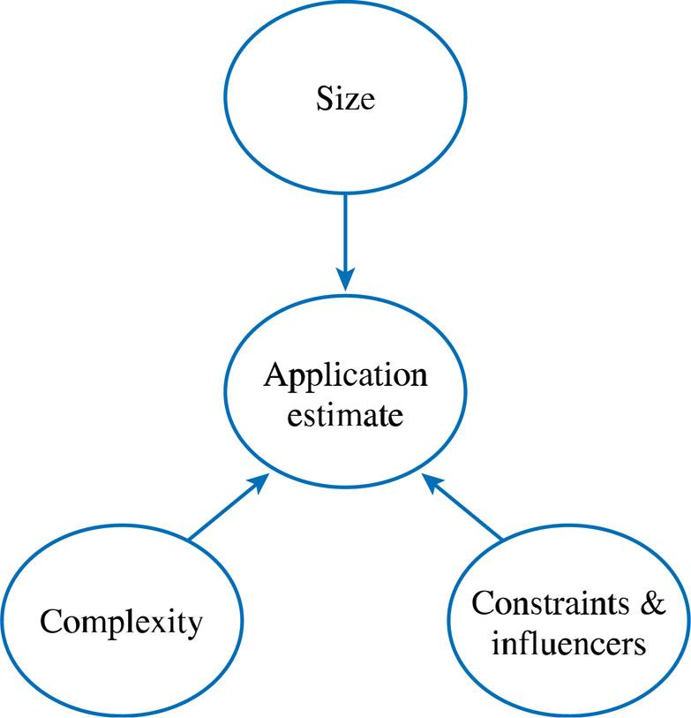
Software estimation model: Adapted from Garmus & Heron 1996, Jones 1998, Royce 1998
‹#›

Slide 11
Software Engineering Metrics and Approaches -
Lines of Code (LOC) – involves counting the number of lines of code in computer programs in sizing the application product.
Controversial issues:
what counts as lines of code? Comments? Declaration of variables?
Experienced programmers tend to write less code than novice programmers
Also depends on programming languages
It is much easier to count the lines of code after a program is written than it is to estimate how many lines of code will be required to write the program
‹#›

Slide 12
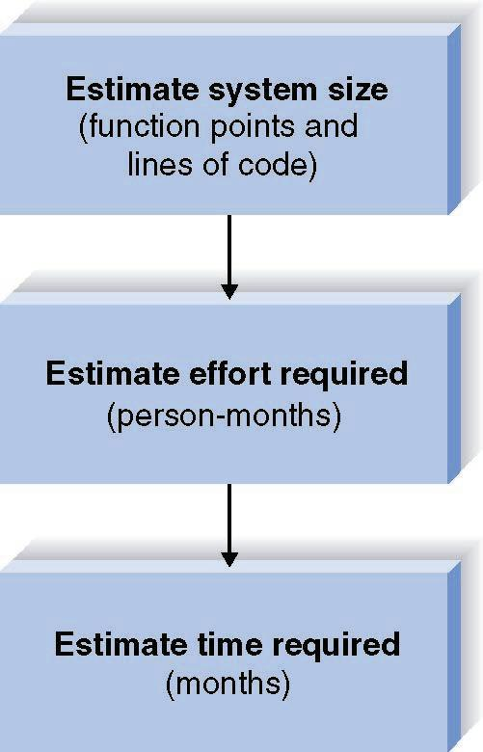
Project Estimation Using the Function Point Approach
PowerPoint Presentation for Dennis, Wixom, & Roth Systems Analysis and Design, 3rd Edition
Copyright 2006 © John Wiley & Sons, Inc. All rights reserved.
3 - ‹#›

Slide 13
Function Points
Focus on the functionality and complexity of a application system or a particular module.
Are independent of technology
This metric is very useful for data processing (transaction-processing) systems that are input and output intensive.
Productivity is expressed as the number of function points that are implemented per person-month.
‹#›

Slide 14
Function Points
Key to counting function points is a good understanding of the user requirements
Function point analysis can be conducted at various stages of the project’s life cycle:
At the scope definition stage
During the analysis and design stages
After implementation to assess if all the functionality was delivered
‹#›

Slide 15
Function Point Analysis
Based on the evaluation of five data and transactional types that define the application boundary:
Internal logical files (ILF)
External interface files (EIF)
External inputs (EI)
External outputs (EO)
External inquiry (EI)
‹#›

Slide 16
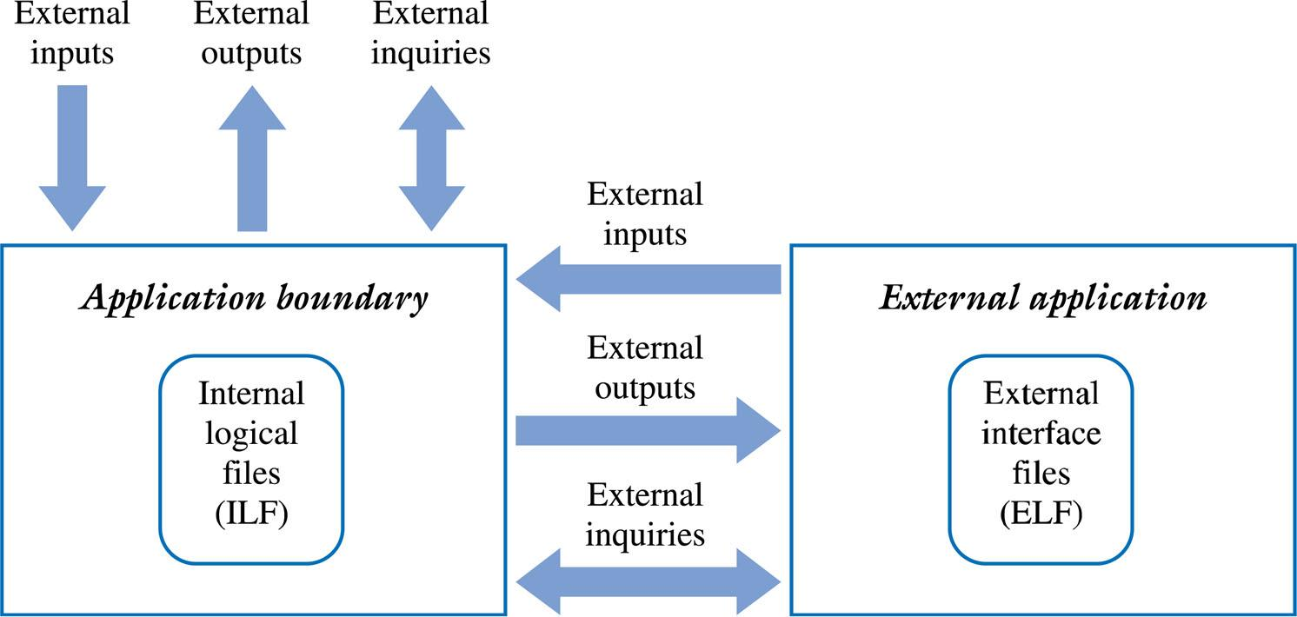
The Application Boundary for Function Point Analysis

Slide 17
Function Point Analysis
Internal logical files (ILF) – stores data within the application boundary. Their complexity classified as low, average or high based on the number of data elements and subgroups of data elements maintained by the ILF. Eg, for an entity Customer, data elements would be customer number, name, address etc. A subgroup would be new customers
External Interface Files (EIF) – similar to ILF, is a file maintained by another application system. Complexity classified as in ILF
External Input (EI) – refers to processes or transactional data that originate outside the application and cross the application boundary from outside to inside
‹#›

Slide 18
Function Point Analysis
External Output (EO) – is a process or transaction that allows data to exit the application boundary. eg reports, confirmation messages, derived or calculated totals, etc
External Inquiry (EQ) – is a process or transaction that includes a combination of inputs and outputs for retrieving data from either the internal files or from files external to the application. EQ do not update or change any data stored in a file. They only read this information. eg queries. Their complexity is classified as low, average, or high, according to the number of files referenced and number of data elements included in the query
‹#›

Slide 19
Example: Spell Checker
External inputs.
The sentences entered to check their spellings
External outputs.
Error message
suggested alternative spellings.
External inquiry.
A lookup table for each word against the internal dictionary
Internal logical files.
Standard dictionary
User entered dictionary
external interface files.
External dictionary
i.e. www.wiktionary.org
to reference for more information
‹#›

Slide 20
Function Point Analysis
Once all the ILF, EIF, EI EO and EQ are counted and their relative complexities rated, an Unadjusted Function Point (UAF) count is determined
Once assessed for complexity each element is given a weighting value ranging from 3 to 15.
The unadjusted function point count (UFC) is then computed as:
UFC = Sum (number of elements of given type) * weight.
‹#›

Slide 21
Computing the UAF
Complexity
Low
Average
High
Total
Internal Logical Files (ILF)
_3 x 7 = 21
_2 x 10 = 20
_1 x 15 = 15
56
External Interface Files (EIF)
__ x 5 = __
_2 x 7 = 14
__ x 10 = __
14
External Input (EI)
_3 x 3 = 9
_5 x 4 = 20
_4 x 6 = 24
53
External Output (EO)
_4 x 4 = 16
_2 x 5 = 10
_1 x 7 = 7
33
External Inquiry (EQ)
_2 x 3 = 6
_5 x 4 = 20
_3 x 6 = 18
44
Total Unadjusted Function Points (UAF)
200

Slide 22
Function Point Analysis cont.
The next step in the function point analysis is then to compute a value adjustment factor (VAF).
The VAF is based on the Degrees of Influence (DI), often called the Processing Complexity Adjustment (PCA), and is derived from the fourteen General Systems Characteristics (GSC), that rate the general functionality of the application system(see table in next slide)
To determine the total DI, each GSC is rated based on the following scale from 0 to 5:
0 = not present or no influence
1 = incidental influence
2 = moderate influence
3 = average influence
4 = significant influence
5 = strong influence
‹#›

Slide 23
General System Characteristics
1. Data Communications: Are data communications required?
2. Distributed functions: Are there distributed processing functions?
3. Performance: Is performance critical?
4. Heavy used configuration : Is the system designed to easily be configured to satisfy different type of requirements?
5. Transaction rate: Does the on-line data entry require the input transaction to be built over multiple screens or operations?
6. Online data entry: Does the system require on-line data entry?
7. End user efficiency: Will the system run in an existing, heavily utilized operational environment?
8. Online update: Are the (master) files updated on-line?
9. Complex processing: Is the internal processing complex?
10. Reusability: Is the code designed to be reusable?
11. Installation ease: Are conversion and installation included in the design?
12. Operational ease: Is the application designed for easy of use of the user?
13. Multiple sites: Is the system designed for multiple installations in different organizations?
14. Facilitate change: Is the application designed to facilitate change?
15. Extensibility: Is the system is designed to easily be extended in future versions?
16. Backup & Recovery: Does the system require reliable backup and recovery?
‹#›
Notes:
The general system characteristics – are derived based on the non-functional requirements from the customer. Non-functional requirements are usually those requirements that convey the attributes to be possessed by the application.
‹#›

Slide 24
General System Characteristic
Degree of Influence
Data Communications
3
Distributed Data Processing
2
Performance
4
Heavily Used Configuration
3
Transaction Rate
3
On-line Data Entry
4
End User Efficiency
4
Online Update
3
Complex Processing
3
Reusability
2
Installation Ease
3
Operational Ease
3
Multiple Sites
1
Facilitate Change
2
Total Degrees of Influence
40
Value Adjustment Factor VAF = o.65 + (TDI /100)
VAF =0.65 + (40 * .01) = 1.05
Total Adjusted Function Points = FP = UAF * VAF
FP = 200 * 1.05 = 210

Slide 25
The calculated function point can be used to estimate lines of code (LOC) depending on the average number of lines of code per function point for a given language.
For example, for the 210 function points:
Developing the system in Cobol would require approximately 23,100 lines of code to write it
210 * 110 = 23,100
Visual basic would take:
210 * 30 = 6,300
(Refer to table on next slide)
‹#›

Slide 26
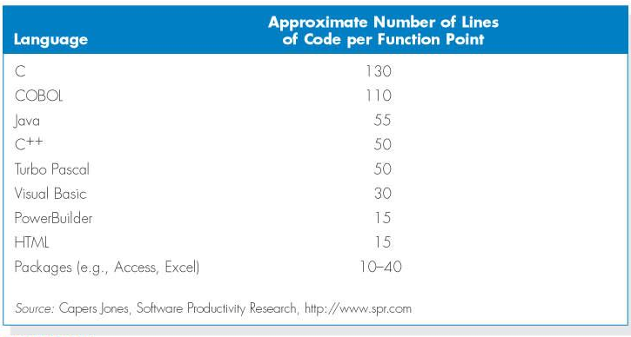
Converting Function Points to Lines of Code
PowerPoint Presentation for Dennis, Wixom, & Roth Systems Analysis and Design, 3rd Edition
Copyright 2006 © John Wiley & Sons, Inc. All rights reserved.
3 - ‹#›
Notes:
‹#›

Slide 27
Function Point Estimation Step Two – Estimate Effort Required
COCOMO (Constructive Cost Model model)
COCOMO predicts the efforts and schedule of a software product based on the project type.
Organic: project deals with developing a well-understood application program, the size of the development team is reasonably small, and the team members are experienced in developing similar methods of projects.
Semidetached: the development consists of a mixture of experienced and inexperienced staff. Team members may have finite experience in related systems but may be unfamiliar with some aspects of the order being developed.
Embedded: the software being developed is strongly coupled to complex hardware, or if the stringent regulations on the operational method exist.
PowerPoint Presentation for Dennis, Wixom, & Roth Systems Analysis and Design, 3rd Edition
Copyright 2006 © John Wiley & Sons, Inc. All rights reserved.
3 - ‹#›
Notes:
‹#›

Slide 28
Function Point Estimation Step Two – Estimate Effort Required
For the three classes of software products, the formulas for estimating the effort based on the code size are shown below:
Organic: Effort = 2.4(KLOC) ^{1.05} PM
Semi-detached: Effort = 3.0(KLOC) ^{1.12} PM
Embedded: Effort = 3.6(KLOC) ^{1.20} PM
If our application is going to be developed in Java, and assuming the project is of medium difficulty, then the semi detached equation will be appropriate:
Effort = 3.0 x(KLOC)^{1.12}
= 3.0 x (11.55)^{1.12}
= 46.47 Person Months
PowerPoint Presentation for Dennis, Wixom, & Roth Systems Analysis and Design, 3rd Edition
Copyright 2006 © John Wiley & Sons, Inc. All rights reserved.
3 - ‹#›

Slide 29
Function Point Estimation Step Three - Schedule Time
For the three classes of software products, the formulas for estimating the development time based on the effort are given below:
Organic: Tdev = 2.5 (Effort) ^{0.38} Months
Semi-detached: Tdev = 2.5 (Effort) ^{0.35} Months
Embedded: Tdev = 2.5 (Effort) ^{0.32} Months
Since our semi-detached project requires 46.47 person months, the duration of the development will be:
Duration = 2.5 x (Effort) ^{0.35}
= 2.5 x (46.47) ^{0.35}
=9.58 Months
PowerPoint Presentation for Dennis, Wixom, & Roth Systems Analysis and Design, 3rd Edition
Copyright 2006 © John Wiley & Sons, Inc. All rights reserved.
3 - ‹#›
Notes:
‹#›

Slide 30
Exercise
A target product has 7 simple inputs, 2 average inputs and 10 complex inputs. There are 56 average output, 8 simple inquires, 12 average master files, and 17 complex interfaces. Determine the unadjusted unadjusted function points (UFP)
If the total degree of influence for the product of the question above is 49, determine the number of function point
Assuming the project can be categorised as organic, calculate the effort in person-months and time /schedule estimates in months
PowerPoint Presentation for Dennis, Wixom, & Roth Systems Analysis and Design, 3rd Edition
Copyright 2006 © John Wiley & Sons, Inc. All rights reserved.
3 - ‹#›
Notes:
‹#›

Slide 31
Project Management Tools and Techniques
3 - ‹#›
PowerPoint Presentation for Dennis, Wixom, & Roth Systems Analysis and Design, 3rd Edition
Copyright 2006 © John Wiley & Sons, Inc. All rights reserved.
.
Notes:
‹#›

Slide 32
Gantt Charts
This is a visual representation of the project activities and their durations. The vertical axis represents the activities, and the horizontal axis represents the duration.
Example:
The table in the next slide represents a software project specification with estimated project activity durations, and their precedence requirements. Draw a Gantt chart for the project.
Notes:
‹#›

Slide 33
Project specifications
Activity | Activity Description | Duration(weeks) | Precedents
A | Hardware selection | 6 | -
B | Software design | 4 | -
C | Install Hardware | 3 | A
D | Code and Test Software | 4 | B
E | File Take-on | 3 | B
F | Write User Manual | 10 | -
G | User Training | 3 | E,F
H | Install and Test System | 2 | C,D
Notes:
‹#›

Slide 34
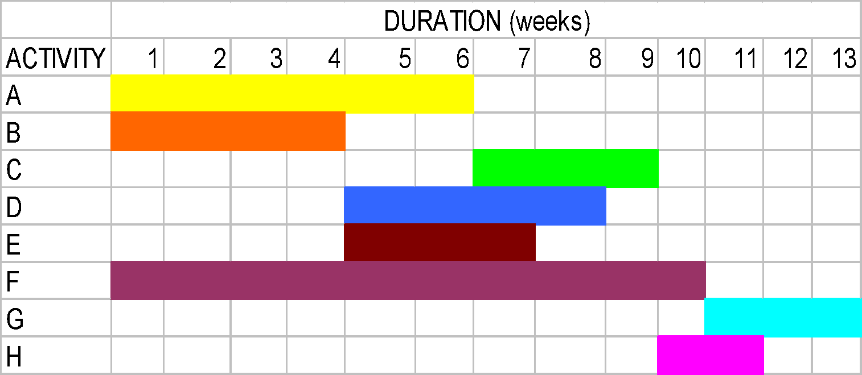
Gantt Chart for the Project
Estimated Project Duration = 13 Weeks
Note: One can use different styles, shades for the duration.
Notes:
‹#›

Slide 35
Network Analysis Diagrams / PERT Chart
A PERT chart is a graphical network model that depicts a project’s tasks and the relationships between those tasks.
Two types:
Activity-on-Arrow (AoA) Diagrams.
Activity-on-Node (AoN) Diagrams.
Notes:
‹#›

Slide 36
Activity-on-Arrow (AoA) Diagrams
The diagram represents activities by links or arrows and the nodes represents events of activities as groups of activities start or finishing.
Rules and conventions are
A project network diagrams may have only one start node.
Project network diagram may have only one end-node.
A link has duration.
Nodes have no duration. Nodes are events and are therefore instantaneous points in time. The source node is the event of the project becoming ready to start and the sink node is the event of the project becoming completed. Intermediate nodes represents 2 simultaneous events i.e.. The event of all activities leading into a node having been completed, and the event of all activities leading out of those nodes being in a position to be started.
Notes:
‹#›

Slide 37
Rules and Conventions for AoA
Time moves from left to right.
Nodes are numbered sequentially.
A network may not contain loops.
A network may not contain dangles.
Notes:
‹#›

Slide 38
Activity-on-Arrow Diagram
C
3
A
D
H
6
4
2
B
End
4
start
3
E
F
G
10
3
ACH = 6+3+2= 11 Weeks. BDH = 4+4+2 = 10 Weeks.
BEG = 4+3+3 = 10 Weeks. FG = 10 + 3 = 13 Weeks = 10+3 = 13 Weeks.
Notes:
‹#›

Slide 39
Activity-on-Node diagrams
The arrows represent the event and the node represent the activity.
The meaning of arrows and the nodes are directly opposite to that of Activity-on-Arrow diagrams.
Project Evaluation and Review Technique (PERT) and Critical Path Modeling are two popular quantitative analysis techniques that are used with the AoN diagrams.
These techniques help managers to plan, schedule, monitor and control large and complex projects.
The critical path consists of the activities that are important and their delay will affect the entire project completion time.
Notes:
‹#›

Slide 40
Example 2:
Activity | Duration | Immediate predecessors
A | 2 | -
B | 3 | -
C | 2 | A
D | 4 | B
E | 4 | C
F | 2 | C
G | 4 | D,E
H | 2 | F,G
Notes:
‹#›

Slide 41
AoN Diagram
Draw an Activity on Node network for example 2
What’s the project’s duration
Notes:
‹#›

Slide 42
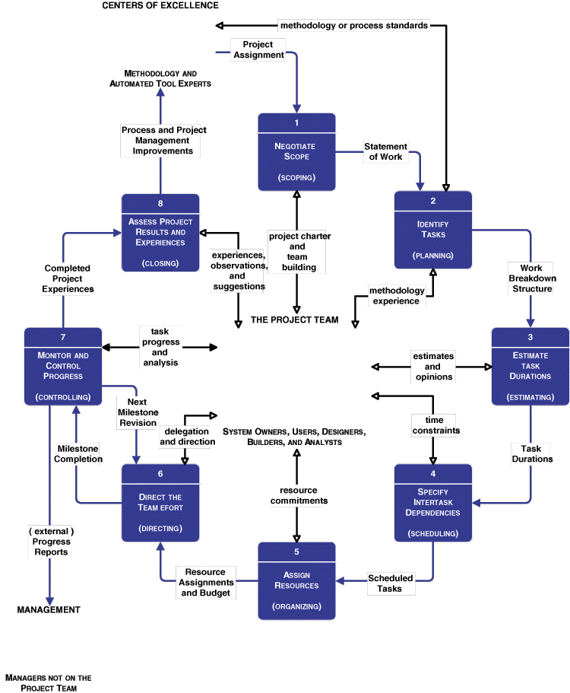



Project Management Life Cycle
Notes:
Chapter 4 - Project Management
‹#›
Notes derived from System Analysis and Design Methods by Whitten, Bentley and Dittman

Slide 43
Joint Project Planning Strategy
Joint project planning (JPP) is a strategy wherein all stakeholders in a project (meaning system owners, users, analysts, designers, and builders) participate in a one-to-three day project management workshop, the result of which is consensus agreement on project scope, schedule, resources, and budget. (Of course, subsequent workshops or meetings may be required to adjust scope, budget, and schedule.)
Notes:
Chapter 4 - Project Management
‹#›
No additional notes

Slide 44
Activity 1: Negotiate Scope
Scope defines the boundaries of a project—What part of the business is to be studied, analyzed, designed, constructed, implemented, and ultimately improved?
Product
Quality
Time
Cost
Resources
A statement of work is a narrative description of the work to be performed as part of a project. Common synonyms include scope statement, project definition, project overview, and document of understanding.
Notes:
Chapter 4 - Project Management
‹#›
Teaching Notes
In consulting engagements, the statement of work has become a commonly used contract between the consultant and client. But the approach works equally well for internal system development projects to establish a contract between business management and the project manager and team.

Slide 45
Statement of Work
I. Purpose
II. Background
A. Problem, opportunity, or directive statement
B. History leading to project request
C. Project goal and objectives
D. Product description
III. Scope
(notice the use of your information system building blocks)
A. Stakeholders
B. Data
C. Processes
D. Locations
IV. Project Approach
A. Route
B. Deliverables
V. Managerial Approach
A. Team building considerations
B. Manager and experience
C. Training requirements
D. Meeting schedules
E. Reporting methods and frequency
F. Conflict management
G. Scope management (continued)
Notes:
Chapter 4 - Project Management
‹#›
No additional notes

Slide 46
Statement of Work (concluded)
VI. Constraints
A. Start date
B. Deadlines
C. Budget
D. Technology
VII. Ballpark Estimates
A. Schedule
B. Budget
VIII. Conditions of Satisfaction
A. Success criteria
B. Assumptions
C. Risks
IX. Appendices
Notes:
Chapter 4 - Project Management
‹#›
No additional notes

Slide 47
Activity 2: Identify Tasks
A work breakdown structure (WBS) is a hierarchical decomposition of the project into phases, activities, and tasks.
Milestones are events that signify the accomplishment or completion of major deliverables during a project.
Notes:
Chapter 4 - Project Management
‹#›
Teaching Notes
A WBS may or may not specify milestones.
Teaching Tips
Tasks must be broken down to a level at which they are manageable. Some experts suggest that a task must be accomplished within 40 working hours or further subdivided into tasks until they can.

Slide 48
Work Breakdown Structures
0
PROJECT
GOAL
1 Phase 1 of the project …
2 Phase 2 of the project …
2.1 Activity 1 of Phase 2 …
2.2 Activity 2 of Phase 2
2.2.1 Task 1 of Activity 2.2 in Phase 2
2.2.2 Task 2 of Activity 2.2 in Phase 2
2.2.3 Task 3 of Activity 2.2 in Phase 2
2.3 Activity 3 of Phase 2 …
3 Phase 3 of the project …
1
2
3
=
PHASE
PHASE
PHASE
2.1
2.2
2.3
ACTIVITY
ACTIVITY
ACTIVITY
2.2.1
2.2.2
2.2.3
TASK
TASK
TASK
Notes:
Chapter 4 - Project Management
‹#›
Teaching Notes
An important thing to note is that WBS’s represent a form of outlining and decomposition.
As a rule of thumb, a task is broken down to two or more subtasks, but no task should have more than six subtasks.

Slide 49
Timeboxing
Time-oriented planning
instead of task-oriented approach
Reason: time is limited!
Fixed deadline
Reduced functionality
Prefer the most critical ones!
Satisfies the business
Providing a product
Within expected time frame
PowerPoint Presentation for Dennis, Wixom, & Roth Systems Analysis and Design, 3rd Edition
Copyright 2006 © John Wiley & Sons, Inc. All rights reserved.
3 - ‹#›

Slide 50
Timeboxing Steps
Set delivery date
Deadline should not be impossible
Should be set by development group
Prioritize features by importance
Build the system core
Postpone unfinished functionality
Deliver the system with core functionality
Repeat steps 3-5 to add refinements and enhancements
PowerPoint Presentation for Dennis, Wixom, & Roth Systems Analysis and Design, 3rd Edition
Copyright 2006 © John Wiley & Sons, Inc. All rights reserved.
3 - ‹#›

Slide 51
Activity 3: Estimate Task Durations
1. Estimate the minimum amount of time it would take to perform the task. We'll call this the optimistic duration (OD).
2. Estimate the maximum amount of time it would take to perform the task. We'll call this the pessimistic duration (PD).
3. Estimate the expected duration (ED) that will be needed to perform the task.
4. Calculate the most likely duration (D) as follows:
D = (1 x OD) + (4 x ED) + (1 x PD) 6
Notes:
Chapter 4 - Project Management
‹#›
Teaching Notes
Recognize that the chapter demonstrated only one approach to estimating. The terminology used is consistent with Microsoft Project’s.
Project actually allows the project manager to modify this formula to reflect his or her personal experience.

Slide 52
Activity 4: Specify Intertask Dependencies
Finish-to-start (FS)—The finish of one task triggers the start of another task.
Start-to-start (SS)—The start of one task triggers the start of another task.
Finish-to-finish (FF)—Two tasks must finish at the same time.
Start-to-finish (SF)—The start of one task signifies the finish of another task.
Notes:
Chapter 4 - Project Management
‹#›
The default in most project management software packages is “finish-to-start.” The other options are provided to improve scheduling flexibility based on intertask dependency.

Slide 53
Scheduling Strategies
Forward scheduling establishes a project start date and then schedules forward from that date. Based on the planned duration of required tasks, their interdependencies, and the allocation of resources to complete those tasks, a projected project completion date is calculated.
Reverse scheduling establishes a project deadline and then schedules backward from that date. Essentially, tasks, their duration, interdependencies, and resources must be considered to ensure that the project can be completed by the deadline.
Notes:
Chapter 4 - Project Management
‹#›
Teaching Notes
In the event that the project manager is given a deadline to meet, reverse scheduling strategy is ideal.

Slide 54
Activity 5: Assign Resources
People—inclusive of all the system owners, users, analysts, designers, builders, external agents, and clerical help that will be involved in the project in any way, shape, or form.
Services—a service such as a quality review that may be charged on a per use basis.
Facilities and equipment—including all rooms and technology that will be needed to complete the project.
Supplies and materials—everything from pencils, paper, notebooks, toner cartridges, etc.
Money—A translation of all of the above into the language of accounting—budgeted dollars!
Notes:
Chapter 4 - Project Management
‹#›
Teaching Notes
Before resources can be assigned to a project/task, the analyst must obtain the various stakeholders’ commitment of those resources.

Slide 55
Activity 6: Direct the Team Effort
Stages of Team Maturity (see figure to the right)
ORIENTATION STAGE
Ÿ
Establish structure and rules
FORMING
Ÿ
Clarify team member relationships
Ÿ
Identify responsibilities
Ÿ
Develop a plan to achieve goals
INTERNAL PROBLEM-SOLVING STAGE
Ÿ
Resolve interpersonal conflict
STORMING
Ÿ
Further clarify rules and goals
Ÿ
Develop a participative climate
GROWTH AND PRODUCTIVITY STAGE
Ÿ
Direct team activity toward goals
NORMING
Ÿ
Provide and get feedback
Ÿ
Share ideas–growing cohesion
Ÿ
Individuals feel good about each other
EVALUATION AND CONTROL STAGE
Ÿ
More feedback and evaluation
PERFORMING
Ÿ
Adherence to team norms
Ÿ
Roles of team strengthened
Ÿ
Strong team motivation to share goals
Notes:
Chapter 4 - Project Management
‹#›
No additional notes

Slide 56
Activity 7: Monitor and Control Progress
Progress reporting
Change management
Expectations management
Schedule adjustments—critical path analysis (CPA)
Notes:
Chapter 4 - Project Management
‹#›
No additional notes

Slide 57
Sample Outline for a Progress Report
I. Cover Page
A. Project name or identification
B. Project manager
C. Date or report
II. Summary of progress
A. Schedule analysis
B. Budget analysis
C. Scope analysis (describe any changes that may have an impact on future progress)
D. Process analysis (describe any problems encountered with strategy or methodology)
E. Gantt progress chart(s)
III. Activity analysis
A. Tasks completed since last report
B. Current tasks and deliverables
C. Short term future tasks and deliverables
IV. Previous problems and issues
A. Action item and status
B. New or revised action items
1. Recommendation
2. Assignment of responsibility
3. Deadline
(continued)
Notes:
Chapter 4 - Project Management
‹#›
Teaching Notes
Emphasize that this is merely a sample. Encourage students to consider that many organizations have their own reporting standards to report project progress. In addition, many methodologies provide templates for various reporting needs.

Slide 58
Sample Outline for a Progress Report (concluded)
V. New problems and issues
A. Problems
(actual or anticipated)
B. Issues
(actual or anticipated)
C. Possible solutions
1. Recommendation
2. Assignment of responsibility
3. Deadline
VI. Attachments
(include relevant printouts from project management software)
Notes:
Chapter 4 - Project Management
‹#›
Teaching Notes
Emphasize that this is merely a sample. Encourage students to consider that many organizations have their own reporting standards to report project progress. In addition, many methodologies provide templates for various reporting needs.

Slide 59
Task Splitting and Delaying
The critical path for a project is that sequence of dependent tasks that have the largest sum of most likely durations. The critical path determines the earliest possible completion date of the project.
Tasks that are on the critical path cannot be delayed without delaying the entire project schedule. To achieve resource leveling, critical tasks can only be split.
The slack time available for any noncritical task is the amount of delay that can be tolerated between the starting time and completion time of a task without causing a delay in the completion date of the entire project.
Tasks that have slack time can be delayed to achieve resource leveling
Notes:
Chapter 4 - Project Management
‹#›
No additional notes

Slide 60
Finding the Critical Path
Path refers to a series of connected activities (or intermediate events) between two events in a network.
Critical path refers to the set of activities on a path from the project’s start event to its finish event, if delayed, will delay the completion date of the project.
It is the sequence of dependent tasks that have the largest sum of most likely durations – the longest path
Critical path tasks have no slack time available
Tasks that have slack time can get behind schedule by an amount less than or equal to the slack time without having an impact on the project’s final completion date
To find the critical path, the following times are calculated for each activity:
Earliest start/event time (ES).
Earliest Finish Time (EF).
Latest start time (LS).
Latest finish time (LF).
‹#›
Notes:
‹#›

Slide 61
Calculating Earliest Activity Times: Forward Pass
Earliest Start time is the earliest time an activity can begin without violation of immediate predecessor requirements.
ES = largest of the earliest finish times of immediate predecessors
Earliest Finish Time is the earliest time an activity can end.
EF = Earliest start time + expected activity time
= ES + t.
Before any activity can begin, all of its predecessor activities must be completed I.e the largest EF for all of the immediate predecessor, used in determining ES.
‹#›
Notes:
‹#›

Slide 62
Calculating Latest Activity Times: Backward/Reverse Pass
Latest Start Time is the latest time an activity can begin without delaying the entire project.
LS = latest finish time – activity time
= LF – t
Since all immediate predecessors must be finished before an activity can begin, the latest start time for an activity determines the latest Finish time for its immediate predecessors.
Latest Finish time is the latest time an activity can end without delaying the entire project.
LF = smallest of latest start times for following activities.
‹#›
Notes:
‹#›

Slide 63
Notation
Activity
Duration
ES
EF
LS
LF
e. g
Design
2
0
2
2
4
‹#›
Notes:
‹#›

Slide 64
Critical Path
TASK
D
Duration
Tue 2/20/01
7 days
Tue 2/20/01
0 days
TASK
A
TASK
B
TASK
C
TASK
E
TASK
I
Mon 2/5/01
3 days
Wed 2/7/01
2 days
Fri 2/9/01
2 days
Mon 2/19/01
6 days
Tue 2/27/01
5 days
Mon 2/5/01
0 days
Wed 2/7/01
0 days
Fri 2/9/01
0 days
Tue 2/20/01
1 day
Tue 2/27/01
0 days
TASK
F
TASK
G
The critical path is highlighted in red
Wed 2/14/01
3 days
Fri 2/16/01
2 days
Fri 2/16/01
2 days
Tue 2/20/01
2 days
Slack Time
TASK
H
Thu 2/15/01
1 day
Tue 2/20/01
3 days
Notes:
Chapter 4 - Project Management
‹#›
No additional notes

Slide 65
Critical Path Analysis (and Slack Time)
Using intertask dependencies, determine every possible path through the project.
For each path, sum the durations of all tasks in the path.
The path with the longest total duration is the critical path.
Notes:
Chapter 4 - Project Management
‹#›
Teaching Notes
The explanation of identifying the critical path is a simplified description. Identifying the critical path for large complex projects with many paths can be quite challenging. There are other approaches that can be used to identify the critical path (see Wysocki et al.).

Slide 66
STAFFING THE PROJECT
3 - ‹#›
PowerPoint Presentation for Dennis, Wixom, & Roth Systems Analysis and Design, 3rd Edition
Copyright 2006 © John Wiley & Sons, Inc. All rights reserved.
.
Notes:
‹#›

Slide 67
Staffing Attributes
Staffing levels will change
over a project’s lifetime
Adding staff may add more overhead
Using teams under 8-10 people
can reduce complexity
communication is effective in small teams
If more people required
Create sub-teams
PowerPoint Presentation for Dennis, Wixom, & Roth Systems Analysis and Design, 3rd Edition
Copyright 2006 © John Wiley & Sons, Inc. All rights reserved.
3 - ‹#›

Slide 68
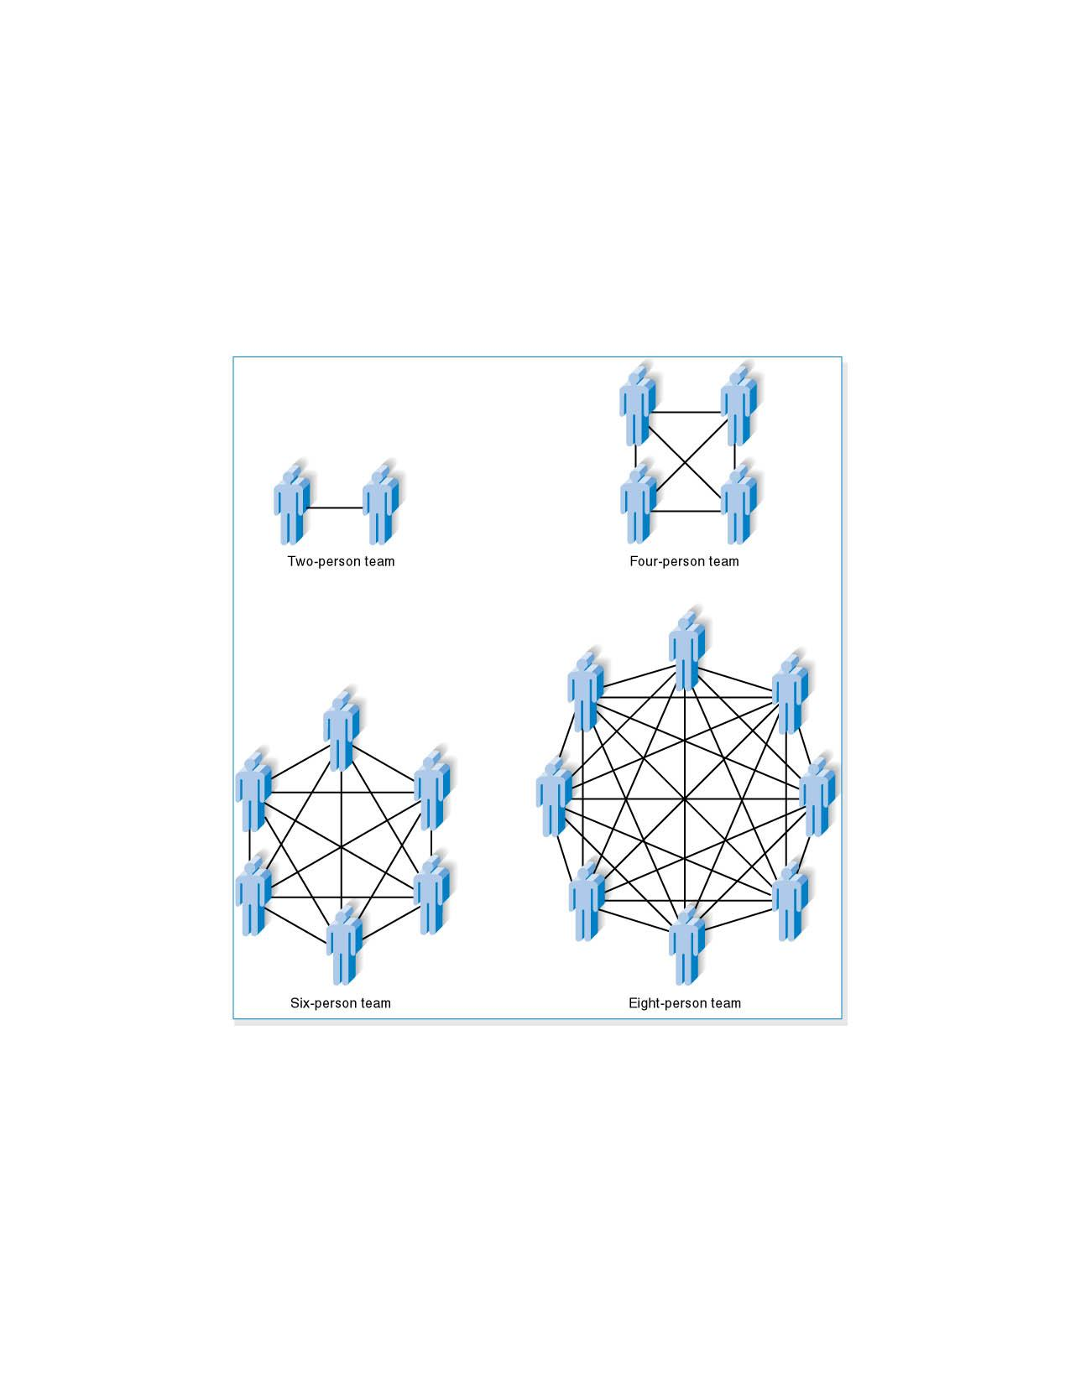
Increasing Complexity with Larger Teams
PowerPoint Presentation for Dennis, Wixom, & Roth Systems Analysis and Design, 3rd Edition
Copyright 2006 © John Wiley & Sons, Inc. All rights reserved.
3 - ‹#›

Slide 69
Key Definitions
The staffing plan
lists the roles
describes the reporting structure
The project charter
describes the project’s objectives and rules
A functional lead
manages a group of analysts
A technical lead
oversees progress of
programmers
and technical staff members
PowerPoint Presentation for Dennis, Wixom, & Roth Systems Analysis and Design, 3rd Edition
Copyright 2006 © John Wiley & Sons, Inc. All rights reserved.
3 - ‹#›
Notes:
‹#›
Charter: Beyanname. patent. patent vermek

Slide 70
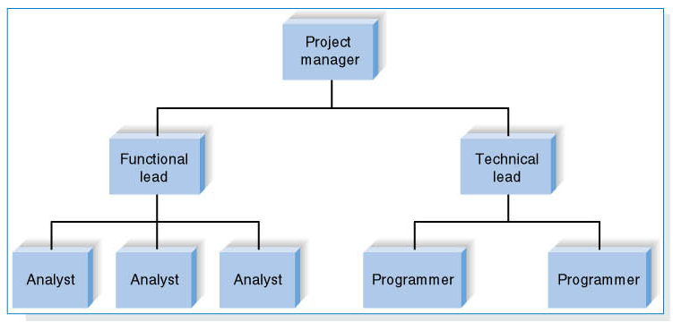
A Possible Team Configuration
PowerPoint Presentation for Dennis, Wixom, & Roth Systems Analysis and Design, 3rd Edition
Copyright 2006 © John Wiley & Sons, Inc. All rights reserved.
3 - ‹#›

Slide 71
Motivation
Use monetary rewards cautiously
Use intrinsic rewards
Recognition
Achievement
The work itself
Responsibility
Advancement
Chance to learn new skills
PowerPoint Presentation for Dennis, Wixom, & Roth Systems Analysis and Design, 3rd Edition
Copyright 2006 © John Wiley & Sons, Inc. All rights reserved.
3 - ‹#›

Slide 72
Handling Conflict
Clearly define project plans
Recognize project importance to organization
Project charter listing norms and groundrules
Develop schedule commitments ahead of time
Forecast other priorities
and their possible impact on the project
PowerPoint Presentation for Dennis, Wixom, & Roth Systems Analysis and Design, 3rd Edition
Copyright 2006 © John Wiley & Sons, Inc. All rights reserved.
3 - ‹#›

Slide 73
COORDINATING PROJECT ACTIVITIES
Standards
Documentation
Managing Risks
3 - ‹#›
PowerPoint Presentation for Dennis, Wixom, & Roth Systems Analysis and Design, 3rd Edition
Copyright 2006 © John Wiley & Sons, Inc. All rights reserved.
.
Notes:
‹#›

Slide 74
Standards
Created to ensure team members follow certain procedures
Formal rules for naming files
Forms indicating goals reached
Programming guidelines
PowerPoint Presentation for Dennis, Wixom, & Roth Systems Analysis and Design, 3rd Edition
Copyright 2006 © John Wiley & Sons, Inc. All rights reserved.
3 - ‹#›

Slide 75
Documentation
Stored in project binder
Documentation is critical
Year 2000 crisis
Good project teams
learn how to document
Continual updating
PowerPoint Presentation for Dennis, Wixom, & Roth Systems Analysis and Design, 3rd Edition
Copyright 2006 © John Wiley & Sons, Inc. All rights reserved.
3 - ‹#›
Notes:
‹#›
Binder: cilt, dosya. klasör

Slide 76
Managing Risk
Create a risk assessment: - A Document that:
tracks potential risks
potential impact on the project
Actions to reduce risks
Prioritize risks according to the
magnitude
Importance
Define scenarios to deal with risks
Continuously check the occurrences of risks
PowerPoint Presentation for Dennis, Wixom, & Roth Systems Analysis and Design, 3rd Edition
Copyright 2006 © John Wiley & Sons, Inc. All rights reserved.
3 - ‹#›

Slide 77
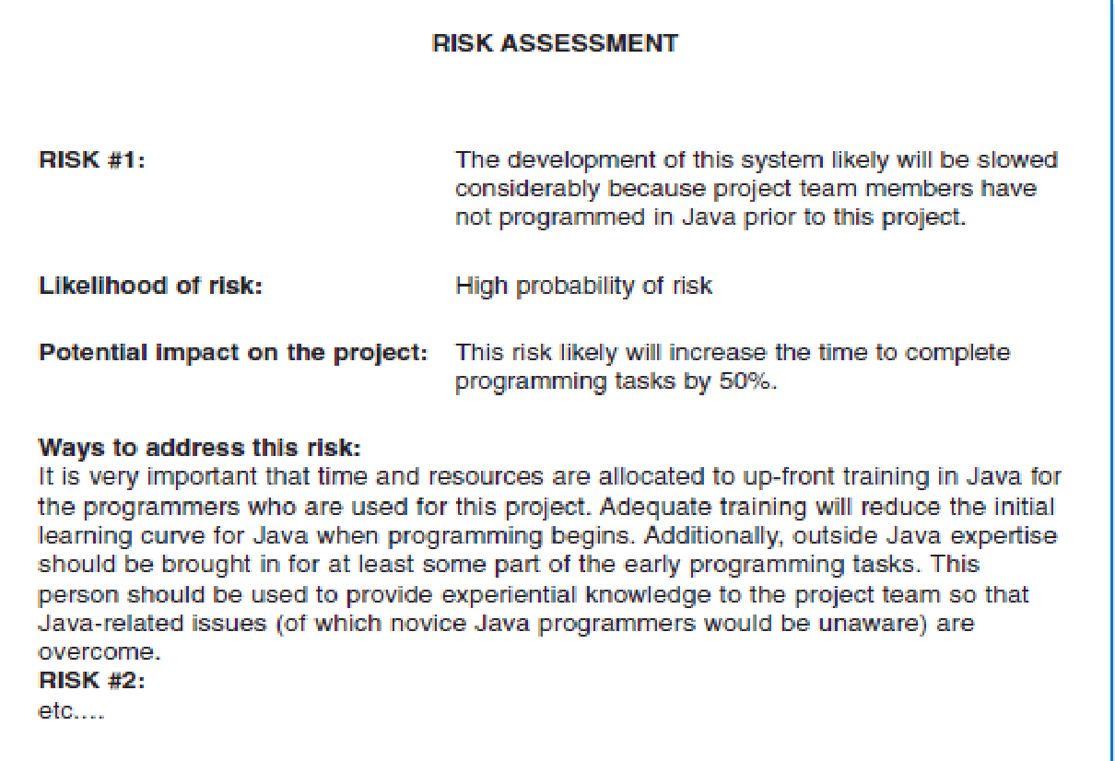
Sample Risk Assessment
PowerPoint Presentation for Dennis, Wixom, & Roth Systems Analysis and Design, 3rd Edition
Copyright 2006 © John Wiley & Sons, Inc. All rights reserved.
3 - ‹#›
Notes:
‹#›

Slide 78
Risk analysis and management
Produce risk assessment document
tracks potential risks
potential impact on the project
Define project risks
Set the importance according to
magnitude
importance
Define the damage risk causes
Set risk mitigation scenarios
Set actions to prevent risks
Set actions to reduce risks
Define the scenarios applied when risk happens
Follow up risk’s realization
Decide if the risk happens
Activate the risk mitigation scenario
‹#›

Slide 79
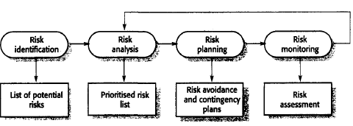
The Risk Management Process
PowerPoint Presentation for Dennis, Wixom, & Roth Systems Analysis and Design, 3rd Edition
Copyright 2006 © John Wiley & Sons, Inc. All rights reserved.
3 - ‹#›
Notes:
From Sommerville (2007), pp 106!
‹#›

Slide 80
Some of Possible Risks
Risk | Risk type | Description
Staff turnover | Project | Experienced staff will leave the project before it is finished.
Management change | Project | There will be a change of organizational management with different priorities.
Hardware unavailability | Project | Hardware which is essential for the project will not be delivered on schedule.
Requirements change | Project and Product | There will be a larger number of changes product to the requirements than anticipated.
Specification delays | Project and Product | Specifications of essential interfaces are not available, on schedule.
Size underestimate | Project and Product | The size of the system has been underestimated.
CASE tool under- performance | Product | Product CASE tools which support the project do not perform as anticipated.
Technology change | Business | The underlying technology on which the system is built is superseded by new technology.
Product competition | Business | A competitive product is marketed before the system is completed.
PowerPoint Presentation for Dennis, Wixom, & Roth Systems Analysis and Design, 3rd Edition
Copyright 2006 © John Wiley & Sons, Inc. All rights reserved.
3 - ‹#›
Notes:
From Sommerville (2007), pp 105!
‹#›

Slide 81
Summary
Project management is critical to successful development of new systems
Project management involves planning, controlling and reporting on time, labor, and costs.
PowerPoint Presentation for Dennis, Wixom, & Roth Systems Analysis and Design, 3rd Edition
Copyright 2006 © John Wiley & Sons, Inc. All rights reserved.
3 - ‹#›

